Slide 1

CMSC 137
Data Communications and Networking
Lecture Module
19 – Internet Protocol

Slide 2
Module 19: Internet Protocol
Rozano S. Maniaol
Lecturer

Slide 3
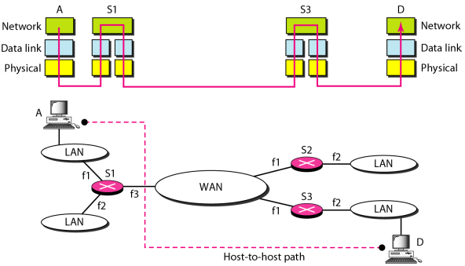
Internetworking

Slide 4
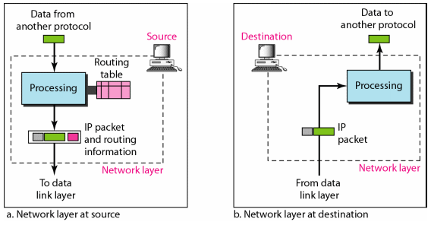
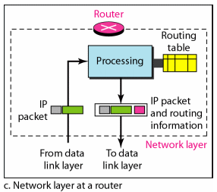
Internetworking

Slide 5
The Internet at the Network Layer
Uses the datagram approach to packet switching
Uses the universal address defined in the network layer to route packets from the source to the destination
Communication is connectionless
Treats each packet independently

Slide 6
IPv4

Slide 7
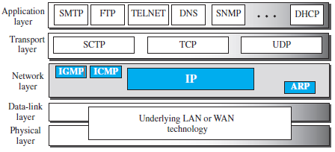
IPv4 in the TCP/IP Protocol Suite

Slide 8
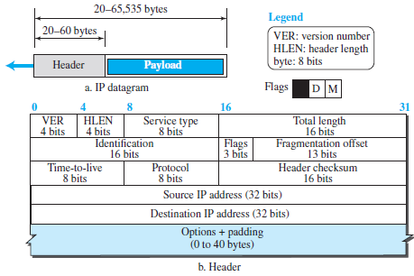
IPv4 Datagram Format

Slide 9
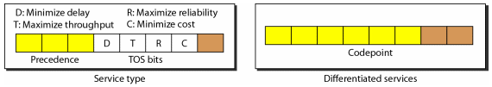
IPv4
Version (VER) – 4-bit field that defines the version of the IPv4 protocol
Header length (HLEN) – 4-bit field that defines the total length of the datagram header in 4-byte words
Service – previously called service type, now called differentiated service

Slide 10
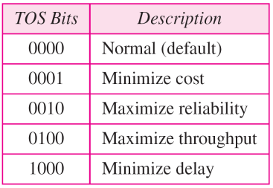
IPv4
Precedence - 3-bit subfield that defines the priority of datagram in issues such as congestion
TOS (Type of Service) bits - 4-bit subfield with each bit having a special meaning

Slide 11
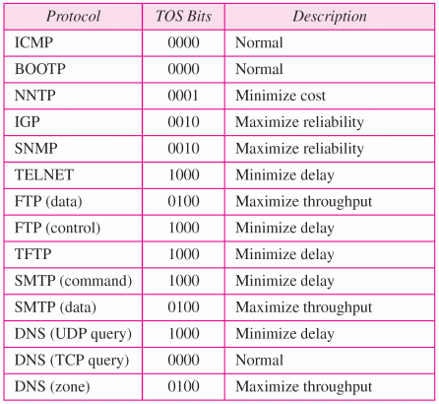
Service Type of Some Applications

Slide 12
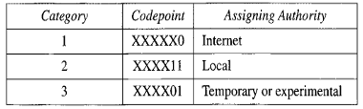
Differentiated Services
First 6 bits make up the codepoint subfield, last 2 bits are not used
  When the 3 rightmost bits are 0s, the 3 leftmost bits are interpreted the same as the precedence bits
  When the 3 rightmost bits are not all 0s, the 6 bit define 64 services based on the priority assignment by the Internet or local authorities

Slide 13
IPv4
Total length – 16-bit field that defines the total length of the IPv4 datagram in bytes
Identification – used in fragmentation
Flags – used in fragmentation
Fragmentation offset – used in fragmentation
Time to live (TTL) – used to control the maximum number of hops (routers) visited by the datagram

Slide 14
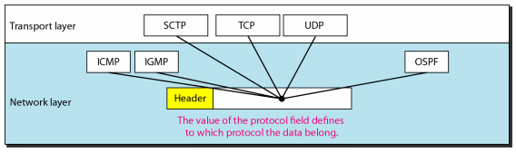
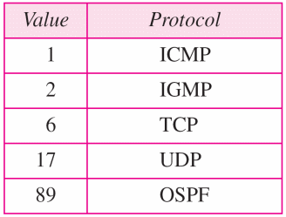
IPv4
Protocol – 8-bit field that defines the higher-level protocol that uses the services of the IPv4 layer

Slide 15
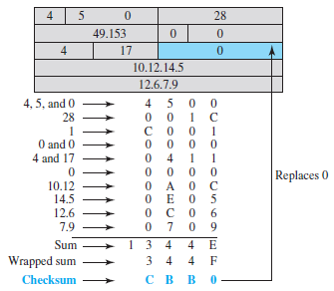
IPv4
Checksum – for error checking, covers only the header

Slide 16
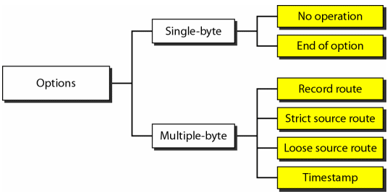
IPv4
Source Address – 32-bit address that defines the IPv4 address of the source
Destination Address – 32-bit address that defines the IPv4 address of the destination
Options – maximum of 40 bytes, used for network testing and debugging

Slide 17
Options
No operation – 1-byte option used as a filler between options
End of option – 1-byte option used for padding at the end of the option field
Record route – used to record the Internet routers that handle the datagram (up to 9 router addresses)
Strict source route – used by the source to predetermine a route for the datagram as it travels through the Internet
Loose source route – similar to strict source route in which each router in the list must be visited, but the datagram can visit other routers as well
Timestamp – used to record the time of datagram processing by a router

Slide 18
Fragmentation
Each data link protocol has its own frame format in most protocol, where one of the fields defined in the format is the maximum size of the data field, the Maximum Transfer Unit or Maximum Transmission Unit (MTU)
When a datagram is encapsulated in a frame, the total size of the frame must be less than the MTU, which is defined by the restrictions imposed by the hardware and software used

Slide 19
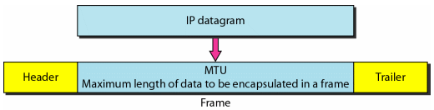
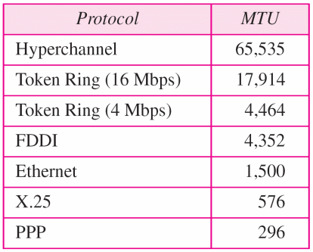
Fragmentation

Slide 20
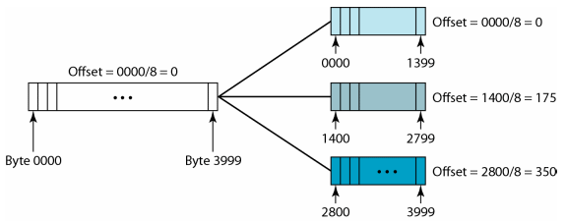
Fragmentation
Identification – 16-bit field that identifies the datagram originating from the source host
Flags – 3-bit field; 1st bit is reserved, 2nd bit is called do not fragment bit, 3rd bit is more fragment bit
Fragmentation offset – 13-bit field that shows the relative position of the fragment with respect to the whole datagram

Slide 21
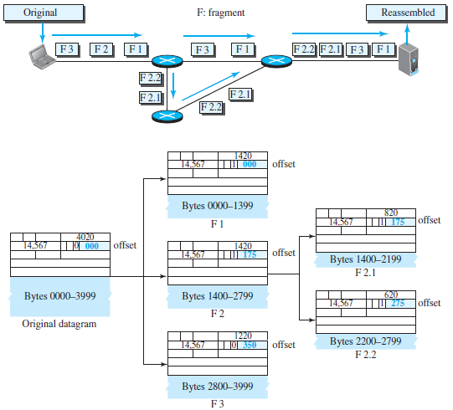
Fragmentation
RSManiaol

Slide 22
IPv6

Slide 23
IPv6
Internetworking Protocol, version 6, also known as IPng (Internetworking Protocol, next generation)
To overcome deficiencies of IPv4
Address depletion is a long-term problem
Internet must accommodate real-time audio and video transmission
Internet must accommodate encryption and authentication of data

Slide 24
IPv6
Advantages
  Larger address space
  Better header format
  New options
  Allowance for extension
  Support for resource allocation
  Support for more security

Slide 25
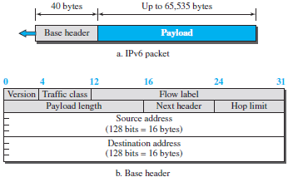
IPv6 Header and Payload

Slide 26
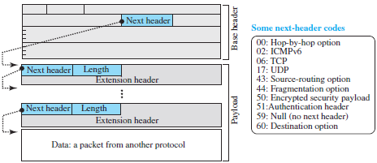
IPv6 Payload

Slide 27
IPv6 Base Header
Version – 4-bit field that defines the version number of the IP
Traffic class – 8-bit field that distinguishes different payloads with different delivery requirements
Flow label – 20-bit field that is designed to provide special handling for a particular flow of data
  A flow is a sequence of packets that share the same characteristics
Payload length – 2-byte field that defines the length of the IP datagram excluding the base header

Slide 28
IPv6 Base Header
Next header – 8-bit field defining the type of the first extension (if present) or the type of data that follows the base header
Hop limit – 8-bit field that serves the same purpose of TTL field in IPv4
Source address – 16-byte IP address that identifies the original source of the datagram
Destination address – 16-byte IP address that identifies the final destination of the datagram

Slide 29
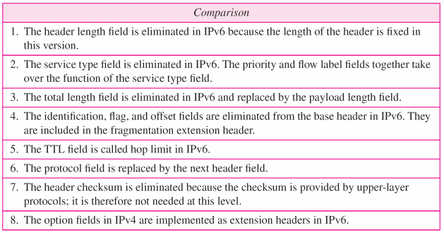
IPv4 vs IPv6 Header

Slide 30
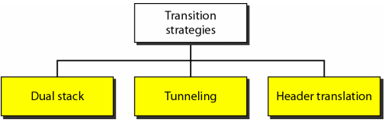
Transition from IPv4 to IPv6

Slide 31
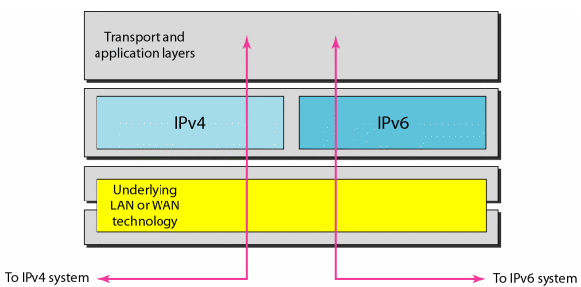
Dual Stack
Station must run IPv4 and IPv6 simultaneously

Slide 32
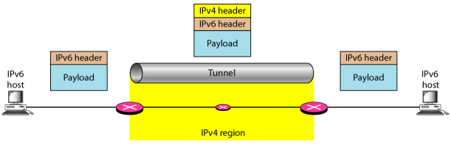
Tunneling Strategy
The IPv6 packet is encapsulated in an IPv4 packet when it enters the region and it leaves the capsule when it exits the region

Slide 33
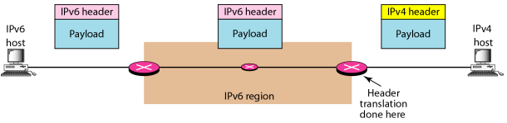
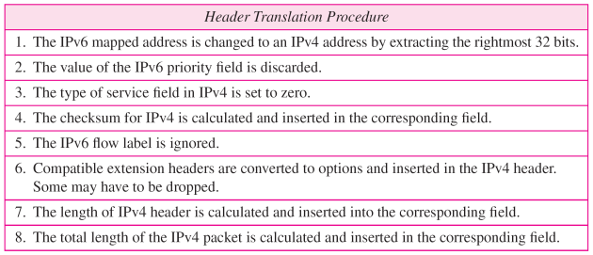
Header Translation

Slide 34
References
Forouzan, B.A. 2013. Data Communications and Networking, 5th Ed. McGraw-Hill, New York.

